Slide 1
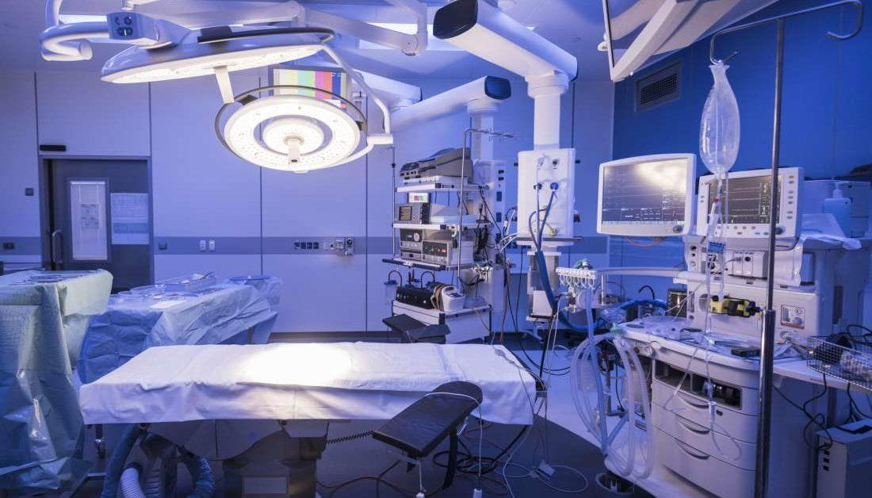
TECHNOLOGIES
IN
SURGICAL LIGHTING

Slide 2

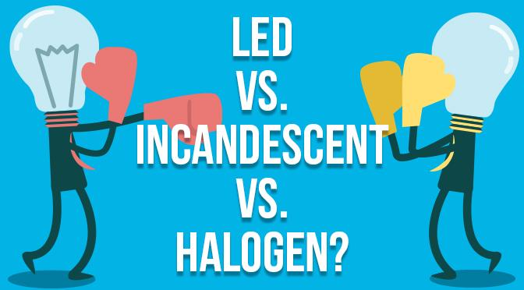
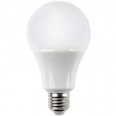
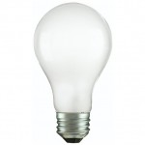
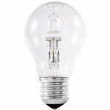
TYPES OF SURGICAL LIGHTS
LED
INCANDESCENT
HALOGEN

Slide 3
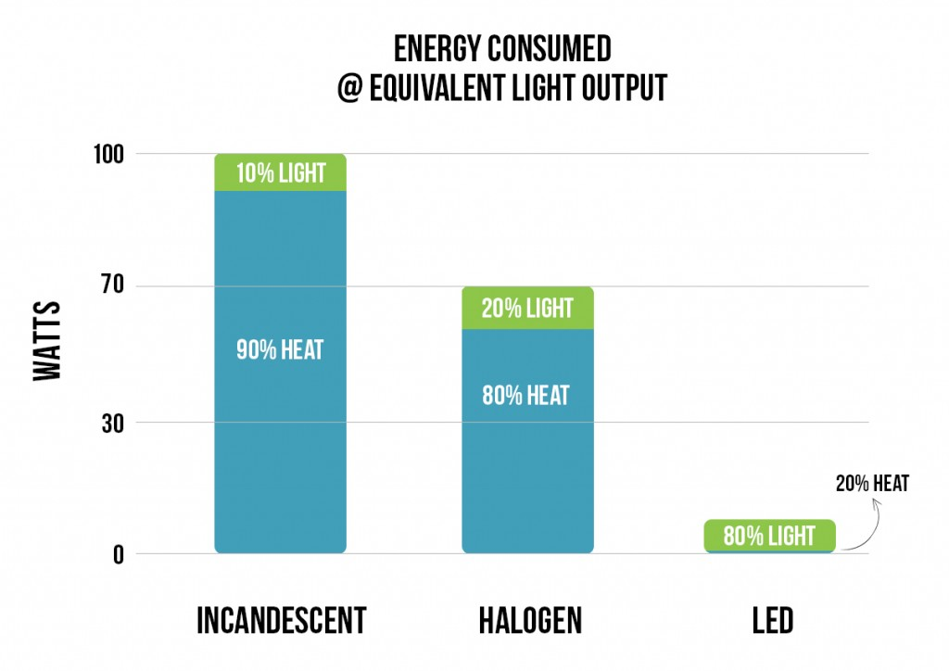
INCANDESCENT
Incandescent bulbs use—at most—10 percent of the energy they consume to make visible light; the other 90 percent is wasted heat.
They produce a considerable amount of infrared (IR) and ultraviolet (UV) radiation.

Slide 4
FEATURES
Incandescent bulbs use—at most—10 percent of the energy they consume to make visible light; the other 90 percent is wasted heat.
They produce a considerable amount of infrared (IR) and ultraviolet (UV) radiation that can be damaging to fabrics and artwork over time.
They’re designed to last around 1,200 hours.
Incandescent bulbs have a fragile glass envelope and brittle filament wire.
These bulbs are relatively cheap but consume so much energy that standard 40- and 60-watt options are no longer available for purchase in the U.S.
They create a warm yellow light.

Slide 5
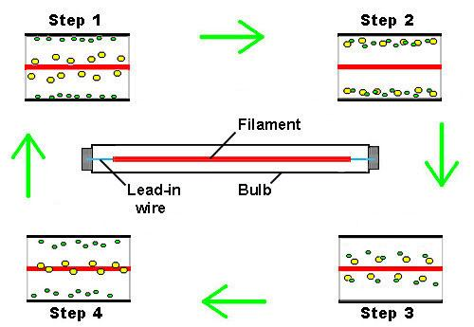
HALOGEN
They contain a tungsten filament, but unlike in incandescent bulbs, a small amount of halogen gas mixes with tungsten vapor and deposits it back onto the filament instead of on the inside of the bulb envelope.

Slide 6
FEATURES
Halogen bulbs come in many shapes but are commonly used as PAR, BR, AR, and MR spotlight or flood light bulbs
.
They produce a considerable amount of infrared (IR) and ultraviolet (UV) radiation that can be damaging to fabrics and artwork
.
These bulbs require an extremely hot running temperature to produce light and can cause burns if touched; the high temperature also prevents these bulbs from functioning as well in cold environments.
Halogen bulbs are extremely sensitive to skin oils, which can cause them to malfunction or burst
.
They last approximately 3,600 hours—three times longer than incandescent bulbs—but are not as efficient as compact fluorescent lamps (CFL) or LED bulbs.
Halogen bulbs have a fragile quartz envelope and brittle filament wire.
Because they operate at higher temperatures, halogen bulbs have higher color temperatures and produce brighter light than incandescent bulbs.

Slide 7
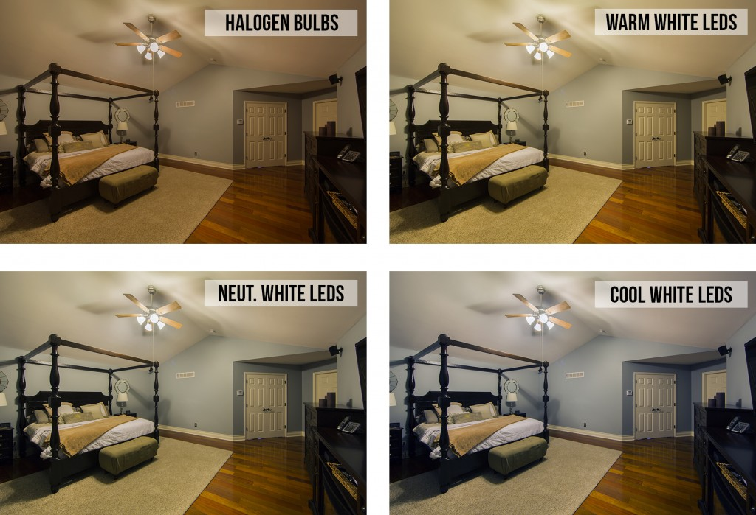
LED
. LEDs produce the longest-lasting, most energy-efficient lighting available today.

Slide 8
FEATURES
LEDs run much cooler than incandescent and halogen bulbs, which greatly increases their longevity and enables them to function in cold temperatures.
Unless an LED is specifically infrared (IR) or ultraviolet (UV), it produces little to no IR or UV radiation, which can be damaging to fabrics and artwork.
They can last up to 50,000 hours—42 times longer than incandescent bulbs and 13 times longer than halogen bulbs.
Power consumption is the lowest compared to all other lighting technologies—80 percent less than incandescent bulbs and 75 percent less than halogen bulbs.
The shatterproof bulbs are shock resistant and have no brittle filaments.
LEDs require higher initial investment but produce greater energy returns over time.
LEDs contain no mercury, harmful gasses, or toxins.
They are available in many different whites and colors.
Because of their low power consumption, LEDs are great alternative lighting solutions for solar-powered systems.

Slide 9
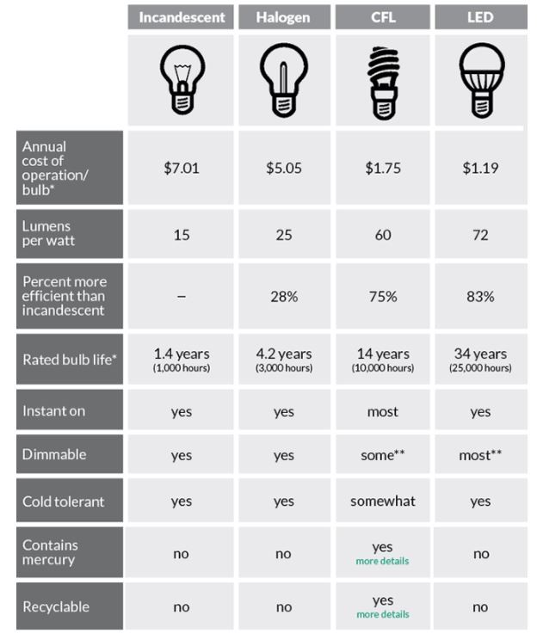
ADVANTAGES

Slide 10
LIGHTING METHODS
Quality lighting is critical for every operating room, and the method of light varies depending on staff needs. Three of the most prevalent methods are:
Overhead/operating lights
2. Headlamps/illuminated loupes
3. In-cavity lighting

Slide 11
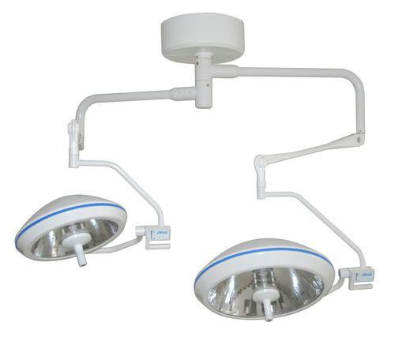
OVERHEAD LIGHTS
Overhead lights are usually either LED or incandescent. The lighting fixture can be mounted on a ceiling or wall and have handles that allow the surgeon to adjust the lighting as they see fit. It is also adjustable to help prevent glare.

Slide 12
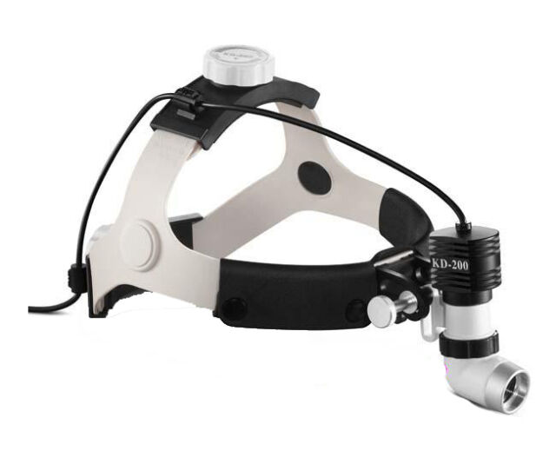
HEAD LAMPS
Headlamps can offer brightness, dependability and comfort for surgeons. The lights are wearable and allow light to follow the attention of the surgeon. Headlamps help create mobility for the surgeon and shadow -free illumination.

Slide 13
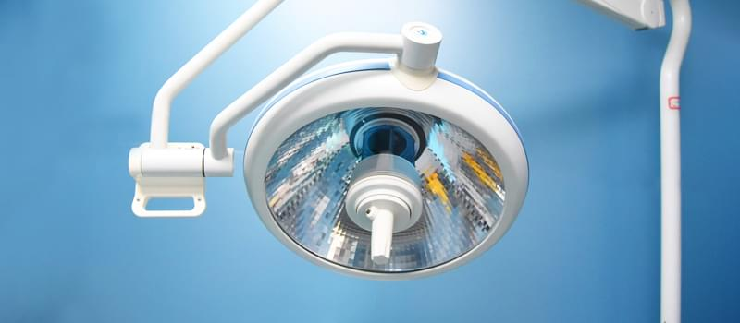
IN CAVITY LIGHTING
In-cavity lighting allows for lighting deep inside surgical cavities. If current overhead and headlamp lighting are not adequate, in-cavity lighting is a viable option.
With this type of light, the light source is typically outside of the sterile field, meaning it can be a fixed light on its own or connected to a surgical retractor or instrument.

Slide 14
TERMINOLOGY
LUX
CENTRAL ILLUMINANCE
LIGHT FIELD CENTRE
DEPTH OF ILLUMINATION
SHADOW DILUTION
D10 AND D50

Slide 15
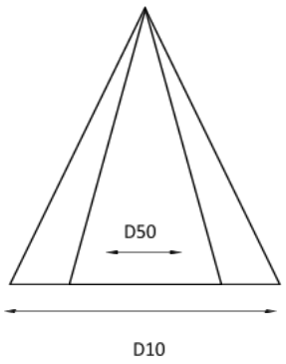
FIELD DIAMETER
The smaller arrow is D50 while the larger arrow is D10. This simply means that 50 percent of the entire pie of light intensity should fall within 50 % of its total diameter.

Slide 16
CERTAIN NORMS
HOMOGENOUS LIGHT
LUX
LIGHT FIELD DIAMETER
COLOUR RENDITION
BACKUP POSSIBILITY
ANNOUNCEMENTS

